Slide 1
Office of <EM, NNSA, SC> <Project Name>
Critical Decision-3
Approve Start of Construction
<ESAAB> or <PMRC> Brief
Presented by: <Name of Briefer> <Title>
<Date of Brief>

Slide 2
Briefing Outline
Purpose
Background
Facility Rendering(s)
Baseline Scope
Baseline Cost Estimate
Baseline Schedule
Funding Profile
Key Performance Parameters
Risk Summary
Project Organization
Key Tailoring Strategies
Independent Reviews
CD-3 Prerequisites
PMRC Issues (If applicable)
Recommendation
Backup

Slide 3
Purpose
Obtain PME approval of Critical Decision-3 for <project name>
Critical Decision-2, Approve Start of Construction/Execution, was approved by <Name, Office Symbol>, on <Date>.
TPC <$xx million>
CD-4 Date <insert month year>
The <Program Office name> Mission
Describe Program Office mission

Slide 4
Background
CD-1, Alternative Selection & Cost Range, approved <date>
….
CD-2, Performance Baseline, approved <date>
….
Cost Range $xxxM - $xxxM
CD-3A, Long Lead Procurement, approved <date>
CD-3A costs $xxxK
Summary progress since CD-2:
…
Target CD-4 Date: Month/Year

Slide 5
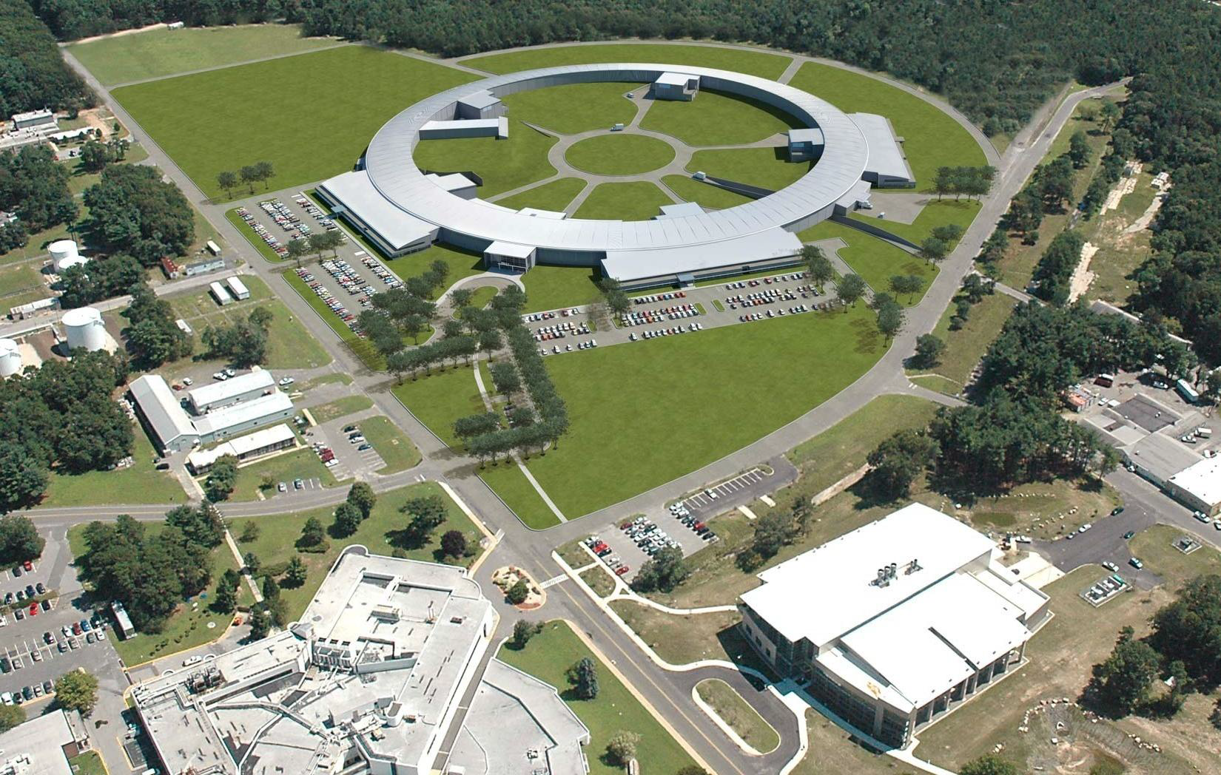
Facility Renderings
Notional

Slide 6
Key Performance Parameters PEP rev. <X>
<these should be the same as those approved at CD-2. If there are changes, it must be discussed with the PME at this time and reflected in the updated PEP>

Slide 7
Baseline Scope
<Describe the scope that is included in this project. This is the scope that will be used to determine success or failure of the project.>

Slide 8
Baseline Cost Estimate
Cost Description |  | ($M)
Total Project Cost (TPC)
Federal Controlled | DOE Contingency
 | Other Government Direct Costs
 | Profit/Fee Opportunity
In Contract | Performance Measurement Baseline (PMB)
 | Management Reserve

Slide 9
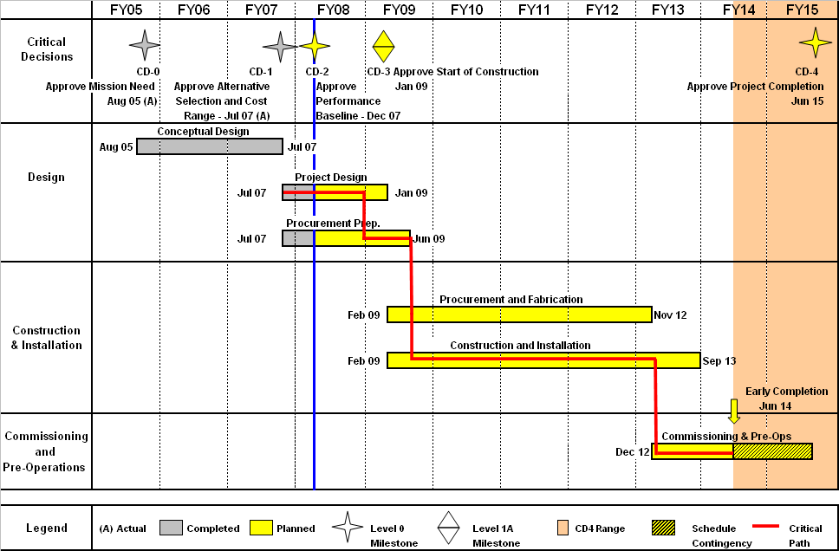
Baseline Schedule
Generate a complete high level schedule for your project with critical path and schedule contingency identified -- use this format/layout.
Notional
ESAAB Briefing Date

Slide 10
Funding Profile
Notional
(Project Name) Funding Profile ($M)
Fiscal Year | FY05 | FY06 | FY07 | FY08 | FY09 | FY10 | FY11 | FY12 | FY13 | FY14 | FY15 | Total
R&D |  |  | 3 | 20 | 10 | 2 | 1 |  |  |  |  | 36
Conceptual Design | 1 | 5 | 19 |  |  |  |  |  |  |  |  | 25
PED |  |  | 3 | 45 | 12 |  |  |  |  |  |  | 60
Construction |  |  |  |  | 66 | 163 | 253 | 166 | 57 | 26 |  | 731
Pre-Ops |  |  |  |  |  |  | 1 | 8 | 24 | 22 | 5 | 60
Total | 1 | 5 | 25 | 65 | 88 | 165 | 255 | 174 | 81 | 48 | 5 | 912

Slide 11
Major Risk Summary
Description | Impact Level | Mitigating Actions
Technology Readiness Level insufficient for CD-2 approval | High | Identify integrated test objectives for each critical technology element to ensure testing is scalable for full size operations and produces best possible design.
Technology Readiness Level insufficient for scheduled start of hot commissioning | High | Plan for integrated full-scale test as part of equipment procurement prior to assembly at the LAWPS construction site.
Environmental permits delayed | High | Continue close integration with Washington State Departments of Ecology and Health to develop permitting activity schedules.
Failed startup test | Medium | Off-site integrated testing at full scale to ensure operability prior to system installation.
Design-affecting requirements change during LAWPS design | Medium | Incorporate updated DOE O 420.1C, DOE-STD-3009-2014, and other applicable updated standards at beginning of preliminary design phase. Freeze code of record at CD-2.
WTP not in alignment with LAWPS | Medium | Continue active participation in One System organization to ensure DFLAW program elements are understood and agreed upon during development.
sRF resin in not available when needed | Medium | Develop supply agreement with sole source supplier and acquire long-term inventory of resin seed stock and beads.
Craft resources availability | Medium | Incorporate resource analysis and hiring processes into field execution schedule.
Equipment damage during construction or startup testing or storage | Medium | Develop critical item list and determine handling requirements to protect equipment and personnel during installation.
Preliminary Documented Safety Analysis approval delayed | Medium | Continue close coordination within DOE and with DNFSB during safety basis development according to latest approved standards during design.
Critical Decision (CD-2, 3A, 3) approvals delayed | Medium | Continue close coordination within DOE to conduct timely project reviews and approval steps.
Notional

Slide 12
Project Organization
Notional
Deputy Secretary of Energy
(Chief Executive for Project Management)
Dr. Elizabeth Sherwood-Randall
Deputy Under Secretary for Performance and Management
Mr. David Klaus
Place an Organization Chart here that clearly indicates the lines of communication / responsibility from the Chief Executive (if a Major System Project ) to the Project Management Executive; all the way down to the project site / team Owner and FPD.
Indicate the names and contact number for each person on the chart.
Assistant Secretary for Environmental Management (Acting)
(Project Management Executive / Project Owner)
Mr. Mark Whitney
Headquarters
Deputy Assistant Secretary for Tank Waste
Mr. Ken Picha
ORP Site
Manager, Office of River Protection
Mr. Kevin Smith
One-System Manager, Office of River Protection
(Project Mentor)
Mr. Ben Harp
FPD Level IV
Contracting Officer
Mr. Wade Hader
CO Level 3
Federal Project Director
Mr. Steve Pfaff
FPD Level I
Integrated Project Team
Chartered
Note: Org chart should show at a minimum - PME, Owner, Respective Chain of Command and FPD

Slide 13
Key Tailoring Strategies
Per the Updated Project Execution Plan (P-PEP):
….
….
….

Slide 14
Independent Reviews
PSO Led reviews (discuss independent reviews, outstanding major issues)
…
…
…
DO APM Independent Cost Estimate and External Independent Review Results (as applicable)
Final Report Completed: <date>
Cost Range Recommended: <insert range here>
<if project team recommending a cost range that differs from DOE APM cost range, provide statement here explaining rationale>
DOE APM validation of PB: <YES or NO>

Slide 15
CD-3 Prerequisites
DOE O 413.3B
CD-2 Approved
Updated CD-2 documentation
Final Design
PEP
Performance Baseline
Acquisition Strategy
PDS/funding documents
Final design review
Compliant Earned Value Management System
EIR (for major system projects)
IPR for Non-Major System Projects
ICE (for projects with TPV >= $100M)
Technology Readiness Assessment
Hazard Analysis Report
Construction Project Safety and Health Plan
Quality Assurance plan
Security Vulnerability Assessment report

Slide 16
PMRC Issues
<Identify those significant issues (as appropriate) that the PMRC should be made aware of>

Slide 17
Recommendation
Recommendation:
Approve CD-3, Start of Construction/Execution for <project name>
COST/TPC: $xxxM
CD-4 Date: <mm/dd/yyyy>

Slide 18
Back-Up Material as Needed

